Slide 1

Extended responses
Learning Intention: To understand how to attack and write an extended response.

Slide 2
What is important to remember when completing an extended response?

Slide 3
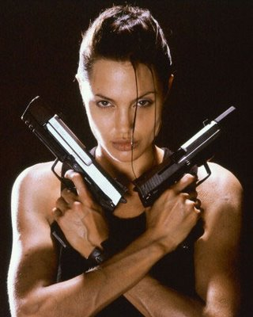
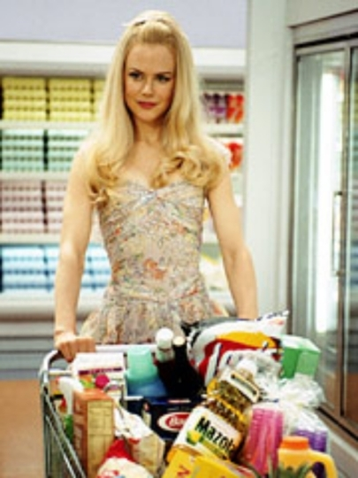
In reference to two different production elements analyse how the two images contrast their representations of gender.
(10 marks)
What is this question asking you?

Slide 4
In reference to two different production elements analyse how the two images contrast their representations of gender.
(10 marks)
Remember this criteria from last lesson?
1/2 mark | Name a production element and a gender stereotype
2 marks | Describe how the production element was used in relevant detail using correct meta language for at least two sub elements.
2 marks | Make clear by describing audience connotations, how the use of the production element constructed the gender stereotype.
1/2 mark | Through use of language, phrasing and choice of vocabulary, paint a vivid picture for the marker of the elements in use and their intended effect.
How would you break down this question into marks?

Slide 5

1/2 mark | Identify two contrasting representations of gender from two different texts and at least one production element
2 marks | Describe how a production element was used in relevant detail using correct meta language for at least two sub elements. (Text A)
2 marks | Link the description of the production element to sophisticated analysis that demonstrates an understanding of a representation of gender as a construction. (Text A)
2 marks | Describe how the production element was used in relevant detail using correct meta language for at least two sub elements. (Text B)
2 marks | Link the description of the production element to sophisticated analysis that demonstrates an understanding of another representation of gender as a construction. (Text B)
1 mark | Provide active analysis of how the two representations of gender contrast against each other.
1/2 mark | Through use of language, phrasing and choice of vocabulary, paint a vivid picture for the marker of the elements in use and their intended effect.

Slide 6

When contrasting texts, what do you need to do?

Slide 7
Image 1 Gender Representation | Image 2 Gender Representation
 | Similarities | Differences
Camera Techniques
Acting
Mise en scene
Lighting
Editing
Sound

Slide 8

Organising your extended response:
GROUP IDEAS TOGETHER
What are some ways that we could organise an extended response?

Slide 9

Your introduction is like an extended topic sentence that highlights and signposts what your analysis will focus on.

Slide 10

PARAGRAPHS
This is the formula for Media writing.
Remember it.
Stick to it.
Do not deviate from it’s simple path.
ESTABLISH AN IDEA
NAME THE CODE
DESCRIBE THE CODE
LINK TO THE IDEA

Slide 11
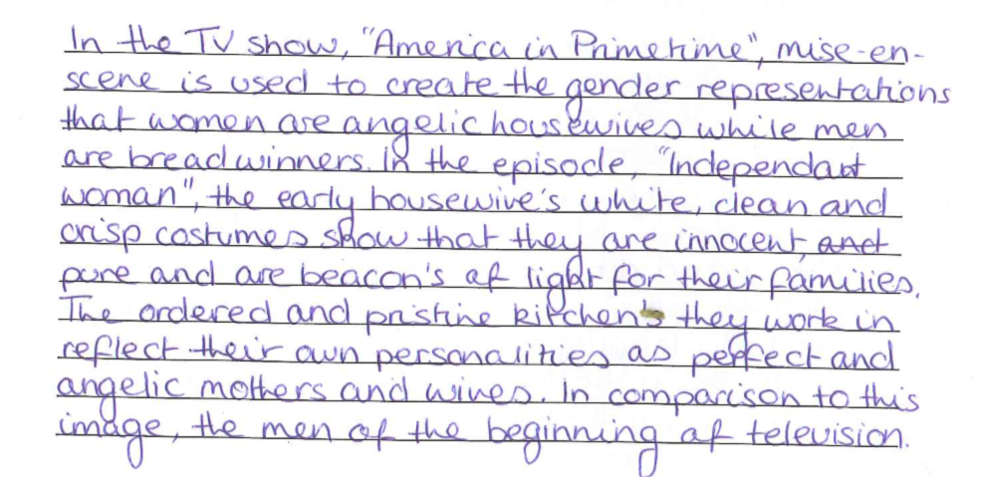
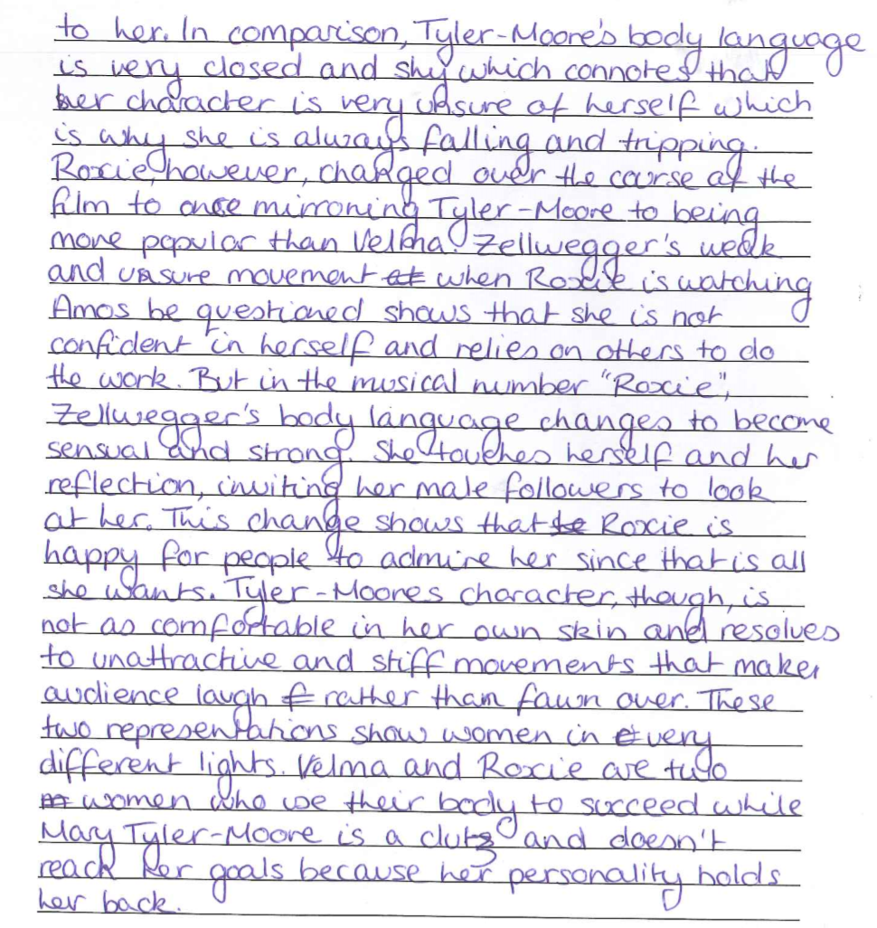

Slide 12

Now it is your turn:
1. Break the question down
2. Organise the structure for an extended response
3. Write the response

