Slide 1
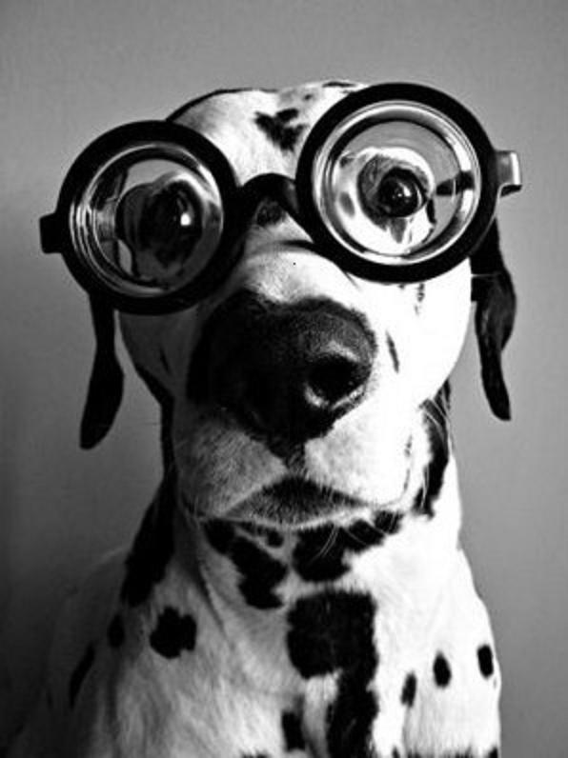
Year 11 Media Mid Year Exam
Learning Intention: To understand the important knowledge and skills required for the mid year exam

Slide 2
What will be on the exam?
The exam will focus only on our first unit of study, that is representations. You will need to know: - Production and story elements: Using accurate terminology, their definitions, sub elements and how they are used to communicate meaning. - How representations are constructed. Including how codes communicate meaning. - How gender is represented and how differing representations contrast.

Slide 3
Code: The signs that communicate meaning Convention: The ways in which signs are combined to communicate meaning beyond their literal meaning.
CODE | CONVENTION
Glasses | Intelligence, knowledge, sophistication.

Slide 4
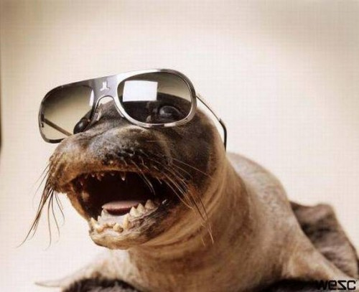
Identify TWO codes from this image and list the conventions.

Slide 5
Using accurate terminology, list the 6 production elements and 7 story elements.
You have 2 minutes

Slide 6
For one of the production elements you identified list at least FOUR sub elements.
You have 1 minute

Slide 7
Element
Sub elements
Adjectives to strengthen analysis

Slide 8
DESCRIBING ELEMENTS
Give enough detail so an assessor who has not seen the text you are referring to can make a judgement on your analysis.
Use adjectives, colour and sub-elements to aide in your description.
Always give at least two sub-elements as evidence in the describe section of your response.

Slide 9
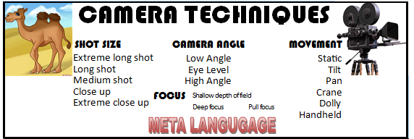
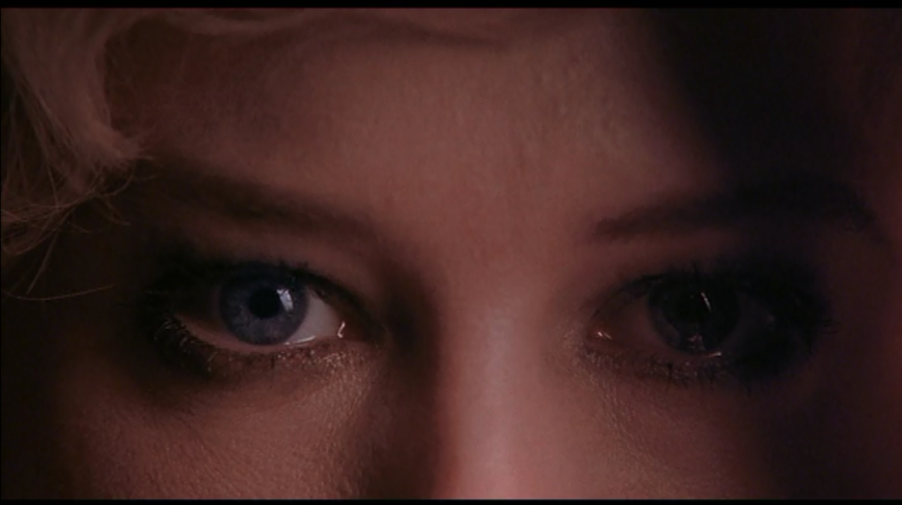
Describing elements
Describe the Camera techniques used in this frame in a sentence.
For your reference, movement was a dolly in.

Slide 10
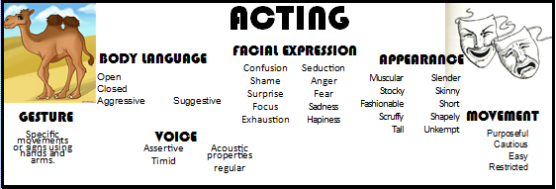
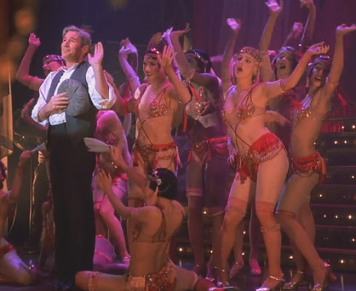
Describing elements
Describe the Acting in this frame frame in a sentence.
For your reference, Richard Gere plays Billy Flyn.

Slide 11
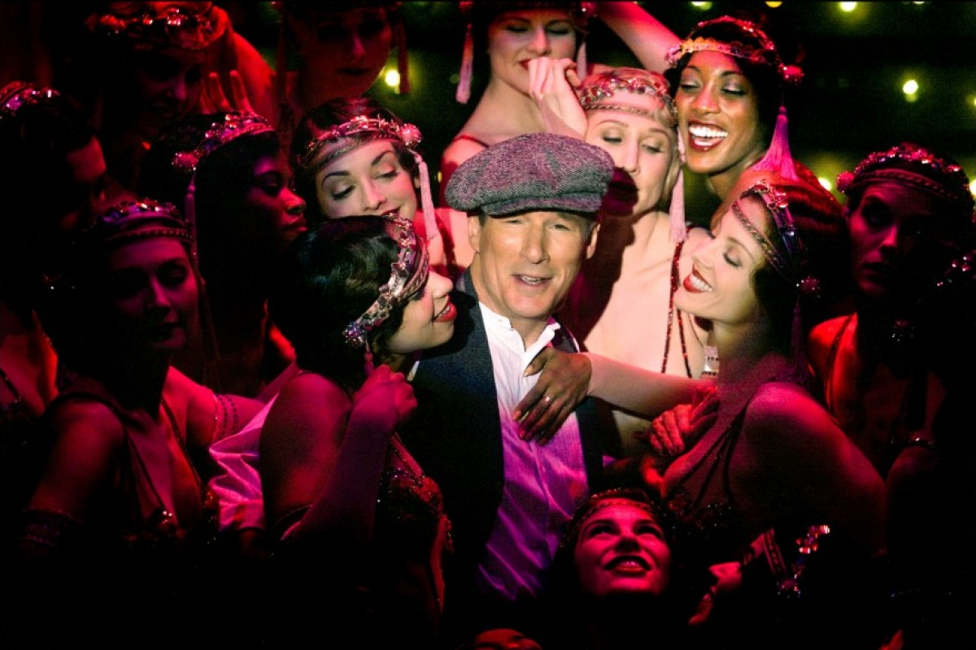
Describing elements
Describe the Mise en scene in this frame in a sentence.

Slide 12
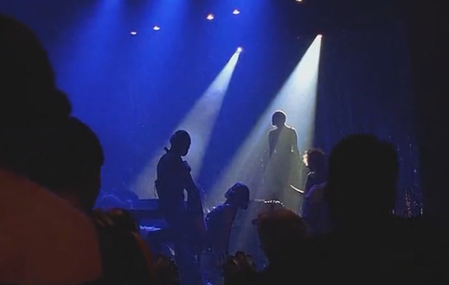
Describing elements
Describe the Lighting in this frame in a sentence.

Slide 13
Simple term | How the term will be phrased on exams | Detail explanation of element
Opening, development and resolution of the narrative | Opening, development and resolution of the narrative | This refers to how ideas and issues are established in the context of the opening sequence and compounded throughout narrative development, and whether they are resolved at the end.
Setting | The function of setting in the narrative | The setting of a narrative is the general location of the action. The setting usually reinforces the action, they are designed to complement and strengthen what the audience sees and the meaning created.
Character and Character relationships | Establishment and development of character and relationships | This includes motivations, what they say, do and how they interact and relate to each other. It also deals with the way look, act and function with a setting, scene or frame. It is also important to understand the similarities and differences between characters and their relationships.
Cause and Effect | Cause and effect | Cause and effect constructs and develops narrative progression, from the initial event that triggers a narrative, through a series of subsequent linked events that develop the plot to its resolution. A text usually begins with one event or situation, something happens to alter or change it (cause and effect).
Structuring of Time | The structuring of time and its impact on narrative progression | Time looks at the order and structure in which events occur, how long they occur for and how often. Many films also deal with time in a non-linear way, meaning the events do not happen in sequence, but jump forward or backwards in time during the film.
Point of View | Point/s of view from which the narrative is presented | The point of view from which the narrative is presented. In most narratives, one characters point of view is privileged over another.
Multiple Storylines | The relationship between multiple storylines | Multiple storylines are common in a narrative film. While most narratives follow one storyline closely, it is common for backstories or complementary stories to run concurrently.

Slide 14
Simple term | How the element will be phrased on exams | Detailed explanation of element
Camera techniques | Camera/Film/Video techniques and technologies including shot selection, movement and focus | Camera techniques refers to how the camera is positioned to capture a scene, and the techniques and qualities that are used. It may be from different angles, or from a distance, or it may be moving. It is also about the depth of field, focus, shot selection and film stock.
Acting | An actor’s facial expressions, tone of voice and body language | Acting refers to specific characterisations, traits or associations that an actor will add to the character to create a personality. It includes: body language, facial expressions, appearance, gesture, and movement.
Mise en scene | The arrangement of elements in front of the camera, closely related to visual composition | Mise en scene incorporates many aspects. This is the way a scene, or particularly a frame is set up. It is how the director places the characters, props or setting to create a look. Take into consideration: colour, costumes, lighting, shots, setting, camera techniques.
Editing | Editing/vision and sound design and mixing, including style, techniques, placement, pace and rhythm of editing | Editing deals with the way shots are put together, or cut to create the effect that the director wants. It is about placement of scenes, timing, pace and rhythm and the relationship between vision and sound.
Lighting | Lighting, including naturalistic and expressive | Lighting involves creating realistic light, shadows, emphasising objects and people within a scene, natural lighting, and expression and setting a scene. It can also be used to create mood.
Sound | Sound, including, dialogue, music and sound effects | This includes sound track, music, sound effects, diegetic and non diegetic, dialogue, pitch, timbre, duration, rhythm and silence. It is used to create mood, atmosphere, convey emotions of characters.

Slide 15
What are some techniques we can use to remember definitions and sub elements?
You have 2 minutes

Slide 16
Media writing
ESTABLISH AN IDEA
NAME THE CODE
DESCRIBE THE CODE
LINK TO THE IDEA
This is the formula for Media writing.
Remember it.
Stick to it.
Do not deviate from it’s simple path.

Slide 17
Media writing
ESTABLISH AN IDEA
NAME THE CODE
DESCRIBE THE CODE
LINK TO THE IDEA
Read the question below:
Describe how one of the production elements identified in part a or b. (mise en scene or acting) was used to construct a gender stereotype in one of the texts you have studied this year.
Identify the idea and code you need to answer this question.
You need to name and describe at least two sub-elements of that code.

Slide 18
Describe how a production element is used to construct gender. (5 marks)

Slide 19
1/2 mark | Name a production element and a gender stereotype
2 marks | Describe how the production element was used in relevant detail using correct meta language for at least two sub elements.
2 marks | Make clear by describing audience connotations, how the use of the production element constructed the gender stereotype.
1/2 mark | Through use of language, phrasing and choice of vocabulary, paint a vivid picture for the marker of the elements in use and their intended effect.
What do each of these mean for you? What do you need to include in your response?

Slide 20
Describe how a production element is used to construct gender. (5 marks)
Let’s write one together!

Slide 21
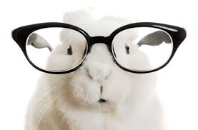
Describe how two production elements combine to construct gender. (6 marks)
Your turn!

