Slide 1
Planning for success: Technologies of Representations: Music Video

Slide 2
Storyboard
The first 20 panels.
WHAT is a storyboard?
HOW and WHY would a director use storyboards?
Remember what we have discussed in relation to creating a quality music video, you need to use a variety of editing and camera techniques.

Slide 3
Handy hints for storyboard success
1. Always draw a horizon line to give your picture perspective. 2. Colour code arrows to indicate movement of camera (green) and actors (red)
3. Give your stick figures elbows and knees so that you can indicate shot size.
4. Give your stick figures a full body, so that you can visualise the space they take up in the frame.

Slide 4
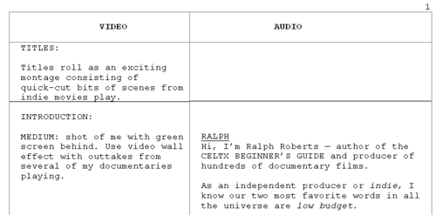
Script
WHAT is a script?
HOW and WHY would a director use a script?

Slide 5
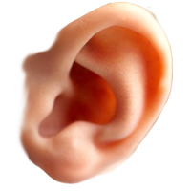
PRESENT TENSE: Like it is happening now. Eg. She runs, sits, laughs (avoid ‘ed’s on the end of words)
AUDIO | VISUAL
Lyrics of the song go here. | The visuals go here. Write screen plays in present tense, active voice ensuring you detail characters, major action and any details of mise en scene that are important in developing your representations. Capitalise character names. Eg. “We see a GIRL sitting on a park bench wearing a panda suit. She watches the river flow in front of her. A small paper boat catches her eye.”
 | You may wish to add a new row if you start a new scene – or to help break up the action and lyrics
ACTIVE VOICE: The sentence revolves around a form of action. The sentences are punchy, direct and make it clear who’s doing what.
What can the audience hear? (include non diegetic and if relevant diegetic sound)
What can the audience see? (include what is on the screen, such as character movement/action, setting, etc)

Slide 6
AUDIO | VISUAL
It was just before the moon hung Her weary heavy head in The gallows and the graves of The milky milky cradle His tears have turned to poppies A shimmer in the midnight A flower in the twilight A flower in the twilight
How do we write this? We see the TEACHER stands at the front of the class. She watches her students eagerly listening.
LOOK and LISTEN carefully and try to draft an audio visual script for the start of this music video.
VIEW: first 45 seconds of: GALLOWS (dir. Emma Freeman) https://www.youtube.com/watch?v=8KCXn9yenHQ&list=UU-KfRe7TQMv2SvQMI9xuo1w

Slide 7
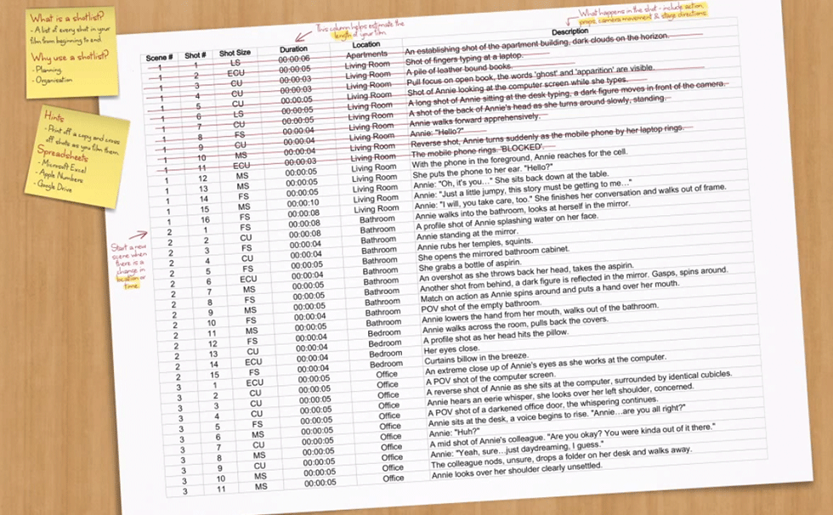
Shotlist
WHAT is a shotlist?
HOW and WHY would a director use shotlist?
VIEW: https://www.youtube.com/watch?v=rVusVLTD8WI
Use this template …
https://drive.google.com/previewtemplate?id=0AsxNmr55SrA_dF9RWUFfTGhublI0ODBZNmNPSU9YbUE&mode=public#

Slide 8
List the first few shots of the COCOROSIE music video.
Camera set ups: locations
Scene # | Shot # | Shot Size | Duration | Location | Description
1 | 1 | MS | 00:00:10

