Slide 1
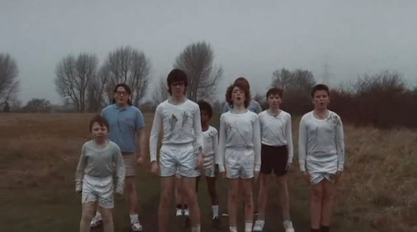
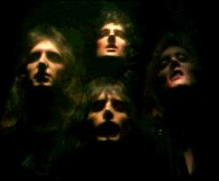
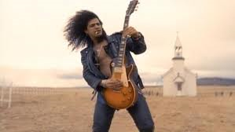
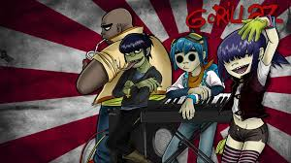
MUSIC
VIDEO
Production
technologies
of
representations
DESIGN PLAN

Slide 2
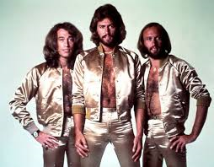
Learning Intentions
To understand the language features and requirements of an Intention Statement and Audience Statement.
success CRITERIA
MUST
Start work on your Production Design Plan
SHOULD
Use the language features from today’s lesson to begin your statements of intention.
COULD
Look at the requirement of a PDP as outlined in the Task sheet and research any parts you don’t understand.

Slide 3
Production Design Plan
√ | ITEM | What does it require?
 | Cover page/ Contents
 | Inspiration
 | Ideas / Brainstorm / Thought process -
 | Intention / Aim
 | Target Audience – Including audience profile, how they will consume the media product and how you will appeal to them
 | Research – Equipment, Genre (codes & conventions), locations, the band, images, inspiration. You must document every bit of research you do and how it will affect your final product. It needs to be extensive and detailed.
 | Character development (personality, costume, appearance, production/story elements)
 | Locations - trial shots of locations, angles, discussion of location relevance and potential issues (traffic, lighting, travel etc)
 | Equipment – a detailed equipment list (& budget if appropriate)
 | Relevant story and production elements- what you want and how you will achieve this
 | Storyboards / Drawings of photos/ sketches of layouts
 | Script / Screenplay/shotlist (include all drafts!)
 | Timeline/ schedule
 | Release documents – Location, talent, personnel, Music copyright
 | Authentication form – This official form must be signed off on three times and included with your final production.
 | Production exercises
 | Communications
 | Anything else relevant to your production.
Today’s lesson is about

Slide 4
Intention Statement
What it is:
This is a 300-500 word statement that articulates the purpose and overall concept for your media product. In your intention statement you may address the following dot points:
What ideas, concepts, themes or issues do you want your music clip to explore?
What do you want people to think about or consider when they engage with your product?
Why are you making this product? What purpose does it serve? (aside from being a school assignment!)
What other work has inspired this product?
What conventions would people need to be familiar with to appreciate this product?
What symbolism and/or motifs are you using in your work and for what intended purpose?
What isn’t it:
This isn’t a place to document the entire storyline of your video or to describe in detail each and every one of your photographs (there will be plenty of time for that later!)

Slide 5
What ideas, concepts, themes or issues do you want your music clip to explore?
Do the lyrics inspire you?
Is there a current event you feel passionate about and want to explore?
Remember it can be simple or complex…
Can you think of something from your own experience or someone else’s that you want to use?

Slide 6
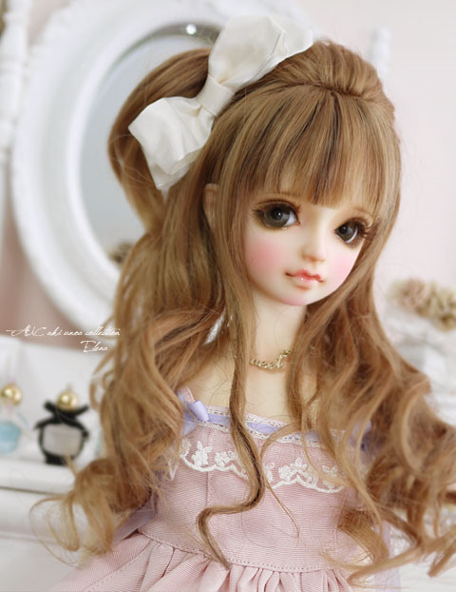
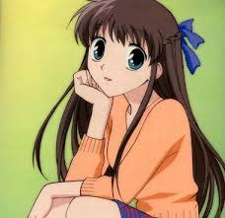
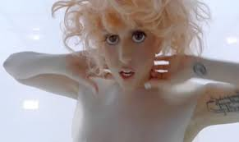
What other work has inspired this product?
Lady Gaga prides herself in her use of intertextuality to create a new “art form”.
Where will you get your ideas from?

Slide 7
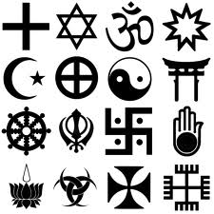
What symbolism and/or motifs are you using in your work and for what intended purpose?

Slide 8
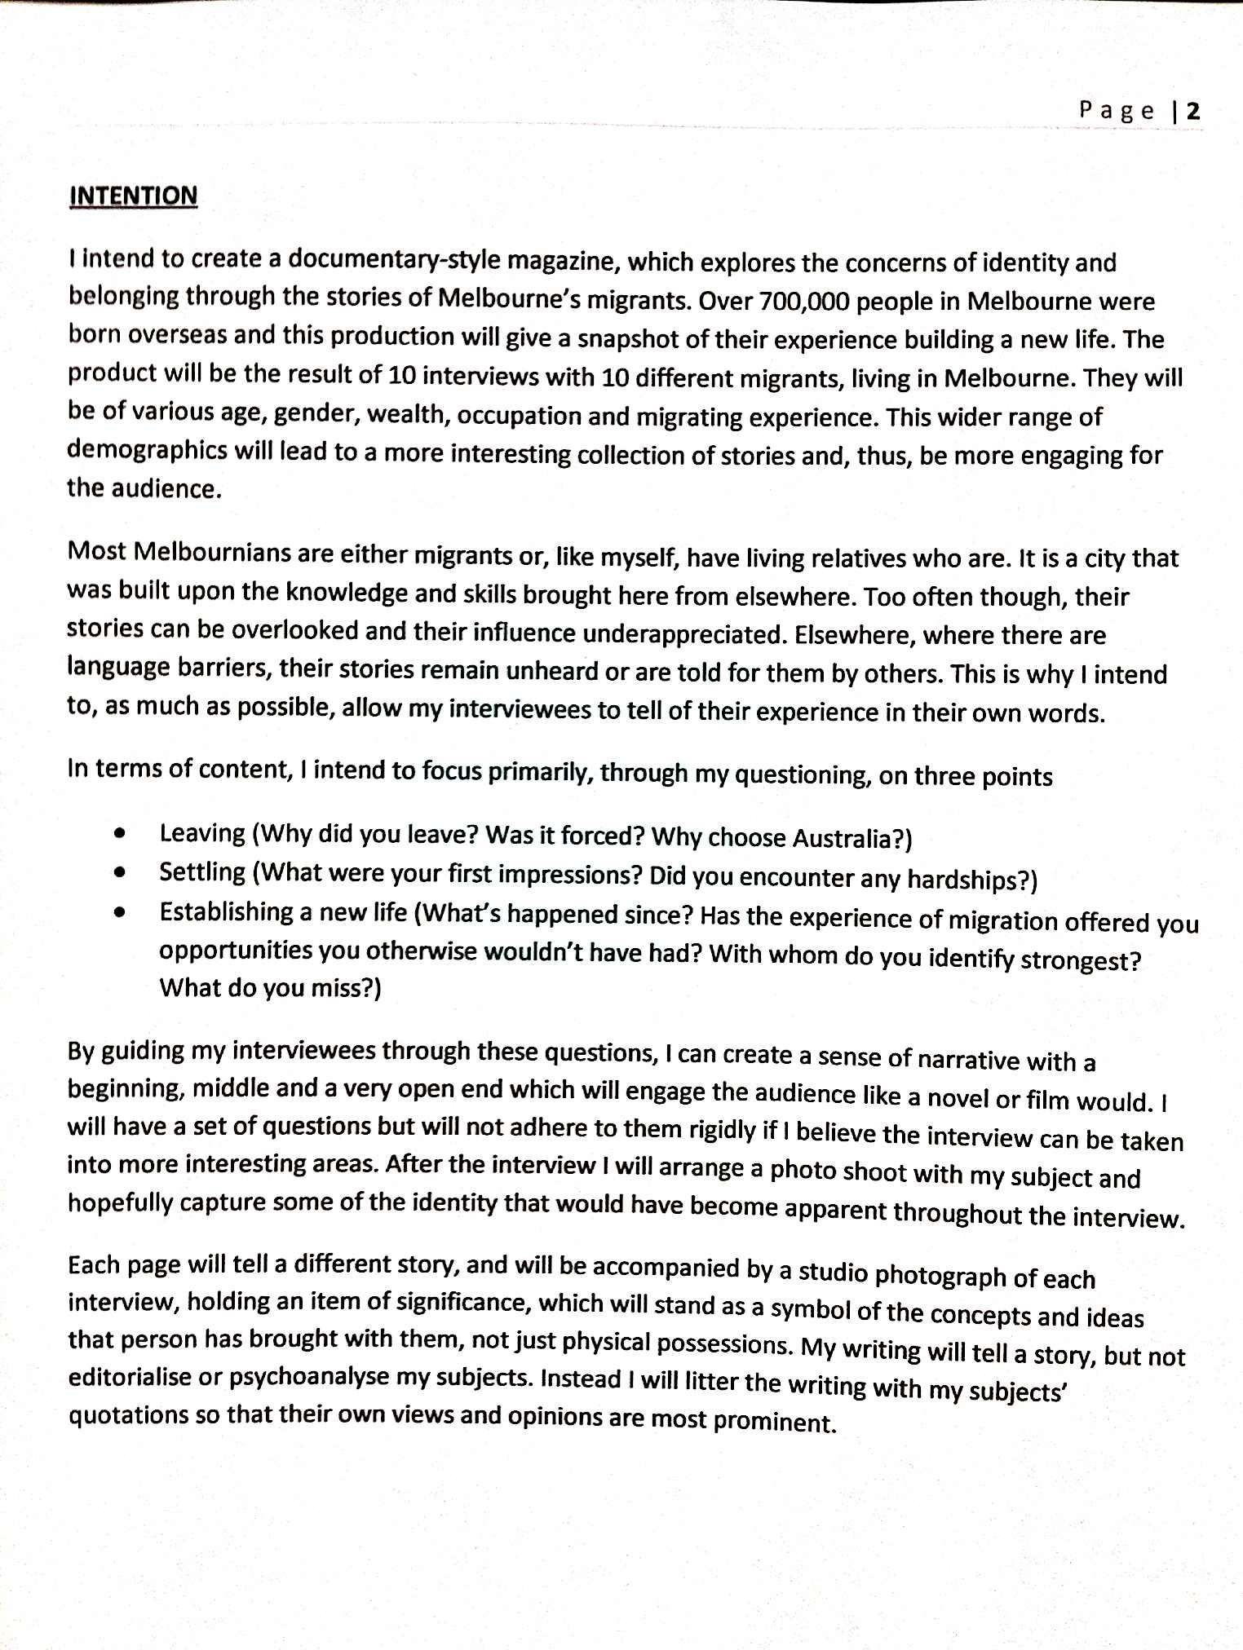
Straight up, let us know what media form you are working in and what genre/style.
Give a rationale for why your concept is important/interesting
Feel free to use dot points to quickly and succinctly outline some key ideas
Sometimes it’s useful to point out what you are NOT on about, in order to clarify your concept to a reader

Slide 9
Audience Statement
What it is?
This is one of the most important aspects of your PDP, in fact criteria 2 which you are assessed against states ‘Development and preparation of a media production design plan in a selected media form for a specified audience’. So if you don’t nail your ‘specified audience’ it’s hard to be successful here.
This is a 300-500 word statement articulating your target audience/s. It should include a description of who they are, what their expectations and knowledge might be and why they would be engaging with your media product. In your audience statement you might address the following dot points.
Some key demographic information (eg. age, gender, where they live, income levels etc.) *note. sometimes not all of these are relevant but most of the time they are so be specific, it’s ok if you feel like you’re stereotyping because in a way that’s what you are doing.
What other media forms and texts does your audience engage with?
What knowledge does your audience bring with them? What conventions etc. are they aware of and expecting from your product?
What aspects of your media product will they engage with and why?
What it isn’t
This isn’t a brief generalisation eg. ‘my target audience is anyone who loves to experience love and passion’.

Slide 10
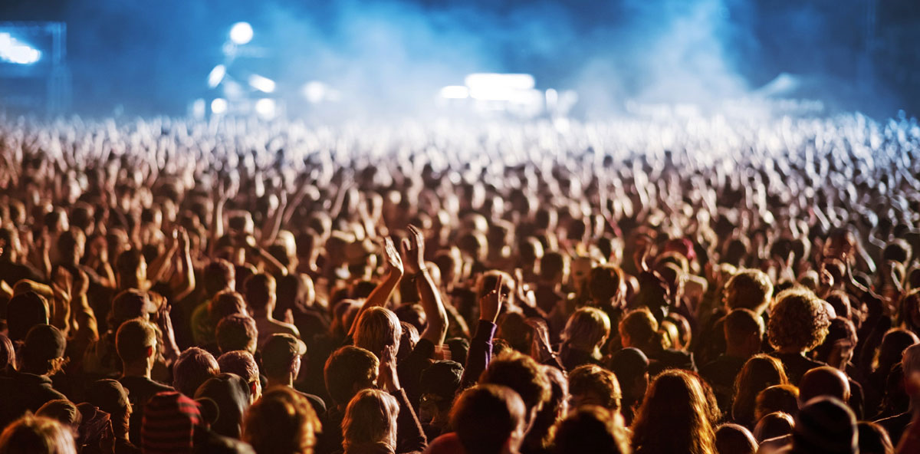
Demographics: who fits yours?

Slide 11
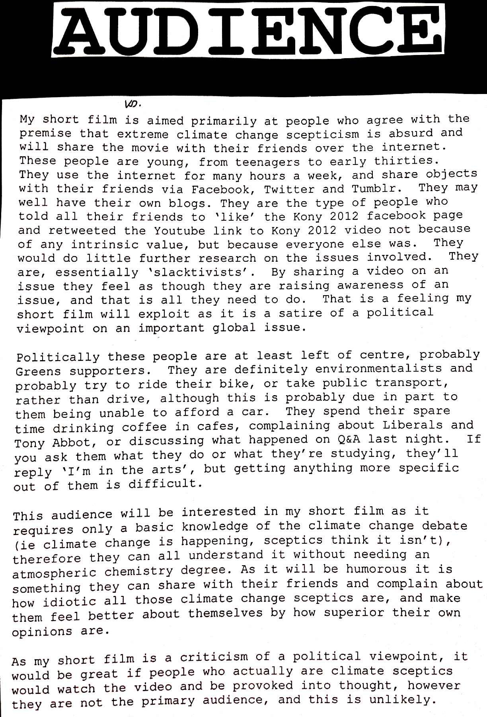
Discuss what other media your audience uses and how they engage with it
Does your audience belong to a group that is commented on in the Media. ‘rev-heads’, ‘hipsters’
Use specific examples to help highlight your audiences activities.
Political views may be relevant
Explain why you audience will be interested in your product.

